Slide 1
🛍️
Customer Shopping
Behavior Analysis
CUSTOMER
BEHAVIOUR
A comprehensive deep-dive into purchasing patterns,
customer segments, revenue drivers & product performance
across 3,900+ customers.
ANALYSIS
3.9K
$59.76
3.75
4
Customers
Avg Purchase
Avg Rating
Categories
Data-Driven Insights | Retail Analytics | 2024

Slide 2
Executive Summary
Key Performance Indicators
👥
💰
⭐
📦
3,900+
$59.76
3.75 / 5
4
Total Customers
Avg Purchase
Avg Rating
Categories
Analyzed dataset
Per transaction
Product satisfaction
Clothing, Accessories,
Footwear, Outerwear
Subscription Breakdown
73%
Non-Subscribers (2,850)
27%
Subscribers (1,050)
73% of customers are not subscribed — significant opportunity for subscription growth.

Slide 3
Revenue Analysis
Category & Gender Breakdown
Revenue by Category
Category Share
Clothing
44%
$104K
Accessories
31%
$74K
Footwear
15%
$36K
Outerwear
8%
$19K

Slide 4
Customer Segments & Demographics
🆕
🔄
💎
New
Returning
Loyal
Customers
Customers
Customers
1 previous
purchase
2-10 previous
purchases
11+ previous
purchases
Revenue by Age Group

Slide 5
Payment Methods & Shipping Preferences
Revenue by Payment Method
Shipping Insights
📦 Standard
$59.24
⚡ Express
$60.41
🆓 Free Shipping
~$59
✈️ 2-Day Air
~$59
🚀 Next Day Air
~$60
🏪 Store Pickup
~$59
Express shipping yields ~2% higher
average spend vs Standard.

Slide 6
Key Analytical Insights
From SQL Analysis
👫 Gender Revenue
🏷️ Discount Behavior
Male vs Female spending patterns are nearly balanced, indicating broad market appeal across both genders.
A significant cohort of customers use discounts yet still spend above the average — price-sensitive but high-value buyers.
🌟 Top Products
📊 Subscriber Spend
Top 5 rated products consistently score above 4.0, pointing to strong quality perception in select lines.
Subscribers show higher avg. spend and greater loyalty versus non-subscribers, validating subscription programs.
🔁 Repeat Buyers
💸 Discount Leaders
Customers with 5+ purchases are more likely to subscribe — loyalty and subscriptions are positively correlated.
5 products top the discount application rate, suggesting where promotional strategy is most impactful.

Slide 7
Product Performance
Top Products & Category Leaders
Clothing — Top 3 Products
Accessories — Top 3 Products
Blouse (1)
Jewelry (1)
Shirt (2)
Handbag (2)
T-Shirt (3)
Belt (3)
Footwear — Top 3 Products
Outerwear — Top 3 Products
Sandals (1)
Coat (1)
Boots (2)
Jacket (2)
Sneakers (3)
Hoodie (3)

Slide 8
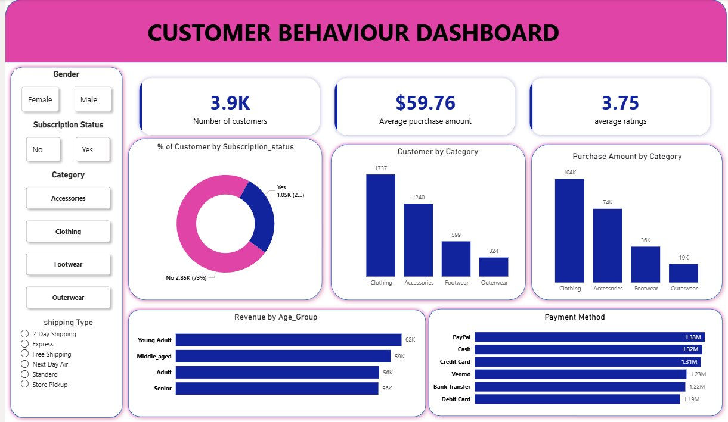
📊 Customer Behaviour Dashboard

Slide 9
Strategic Recommendations
📈
🎯
💳
Boost Subscription Rate
Focus on Clothing
Promote PayPal & Digital Pay
With 73% non-subscribers, targeted campaigns to convert high-frequency buyers can dramatically increase recurring revenue.
Clothing accounts for 44% of revenue. Double down on inventory depth, seasonal campaigns, and cross-sell opportunities.
PayPal and Cash lead payment methods. Incentivize digital payments to reduce cash handling costs.
🏷️
👑
🚀
Optimize Discount Strategy
Reward Loyal Customers
Target Young Adults
High-discount products should be monitored for margin impact. Redirect discounts to low-penetration categories.
Loyal buyers (11+ purchases) are the highest LTV segment. Build a tiered loyalty program to retain and grow this cohort.
Young Adults drive the highest revenue group at $62K. Tailor marketing channels (social/mobile) to capture this segment.

Slide 10
Thank
You
Customer Shopping Behavior Analysis
Key Takeaways
▸ 3,900+ customers analyzed across 4 product categories
▸ Clothing dominates revenue at 44% of total
▸ 73% non-subscriber base — major growth opportunity
Questions &
Discussion
▸ Young Adults are the highest revenue age group
▸ PayPal leads as most-used payment method
▸ Loyal customers show strong subscription correlation

